Slide 1

Shri Ram Murti Smarak College of Engineering & Technology, Bareilly
MINI PROJECT PRESENTATION ON THE TOPIC
"DESIGN AND DEVELOP A SYSTEM FOR RESUME BUILDER“
Presented by: Guided by:
Kushagra Sharma (220014010053) Mr. Imtiyazul Haq
Anjali Sharma (2200140100015) (Assistant Professor)
Dev Saxena (2200140100030)
Group No. 09

Slide 2

CONTENT
Introduction
Problem Statement
Literature Review
Methodology
Technology Used
Result
Conclusion
References

Slide 3
INTRODUCTION
A resume is a formal document that provides an overview of an individual's education, work experience, skills, achievements, and qualifications. Typically used in job applications, a resume serves as a snapshot of the candidate's professional background and capabilities. The purpose of a resume is to showcase relevant information to potential employers, helping them assess the candidate's suitability for a particular job or position. In this project, we aim to use html, JavaScript and other external factors to design and develop a system for resume builders that will feature an intuitive user interface allowing users to input their personal and professional information. The project is designed to be scalable and adaptable, supporting integration with various platforms and formats, such as PDF. This project aims for the creation of resumes that stand out in the competitive job market, ultimately increasing their chances of securing employment opportunities.

Slide 4
PROBLEM STATEMENT
The manual input of personal and professional information can be time-consuming and error-prone, leading inaccuracies in the resume content.
Lack features that provide real-time feedback on resume content and formatting choices.
Some resume-building tools may lack compatibility across various devices, restricting users to specific platforms.
The limitation of accessibility and flexibility, particularly for users who prefer creating or updating their resumes on mobile devices.

Slide 5
The current market lacks accessible and user-friendly solution, discouraging some individuals from using such platforms effectively.
Traditional text-based resumes may not always showcase an individual's skills and experiences effectively.
Many individuals find the process of creating resume daunting and
time-consuming.

Slide 6
LITERATURE REVIEW
Bharti Kungwani et al [1] web application provides resumes of graduates i.e., placed students. It also informs about upcoming company drives and campus placements. The application uses statistical analysis by collecting quantitative data and then represents it in a visual format.
The integration of automated formatting and spell-checking features in resume builders has been explored in studies such as those by Johnson and Lee [2]. It not only reduces the time required for resume creation but also improves the overall quality of resumes by minimizing errors and inconsistencies.

Slide 7
Research by Smith et al. (2018) [3] underscores that platforms with intuitive interfaces, clear navigation, and user-friendly features enhance user satisfaction and overall usability. This literature emphasizes the significance of considering user experience as a central element in the design and development process.

Slide 8
METHODOLOGY
Planning Phase: This phase involved defining the project scope, objectives, and requirements.
Design Phase: The system architecture and user interface were conceptualized. Design decisions were made based on usability principles, ensuring an intuitive and user-friendly experience.
Implementation Phase: The implementation phase focused on translating the design into functional code.
Frontend using HTML structure.
CSS styling.

Slide 9
JavaScript for dynamic user interactions.
Testing Phase: Comprehensive testing was conducted to ensure the quality and reliability of the website.
The final phase involved evaluating the performance and effectiveness of the website.

Slide 10
TECHNOLOGY USED
1.HTML:
Hyper Text Markup Language.
It is the standard markup language used to create web pages.
It provides the structure and layout of a webpage.
It uses markup tags to define different elements and their relationships.
Developed by Tim Berners-Lee in 1991.

Slide 11
2.CSS:
Cascading Style Sheets, commonly known as CSS.
CSS is a fundamental technology used for styling web pages.
It is used for defining the visual presentation of HTML documents.
It is used for layout, appearance, and formatting of web content across different devices and screen sizes.
It enables to apply styles such as text, images, and layout containers, without changing the structure of the document.

Slide 12
3.JavaScript:
Initially developed by Netscape Communications in 1995.
JavaScript is a versatile programming language primarily used for client-side web development.
JavaScript has since become one of the most widely used programming languages on the web.
It allows developers to create dynamic and interactive web pages.

Slide 13
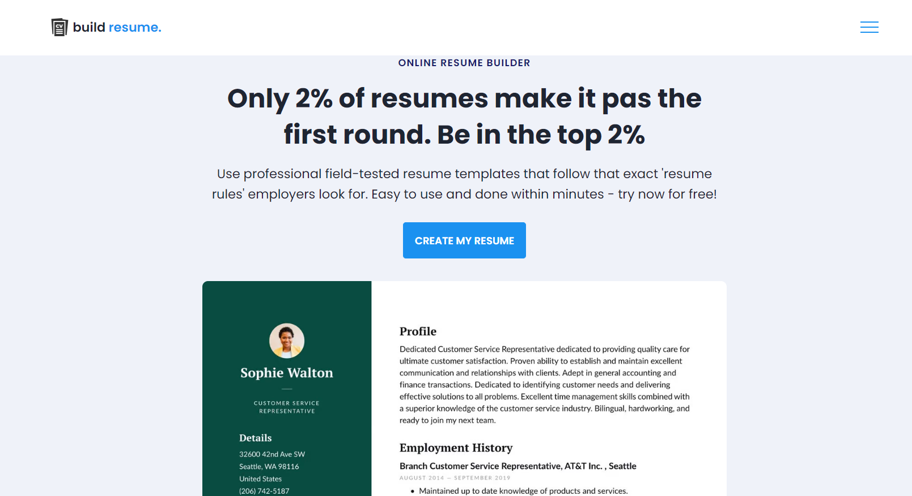
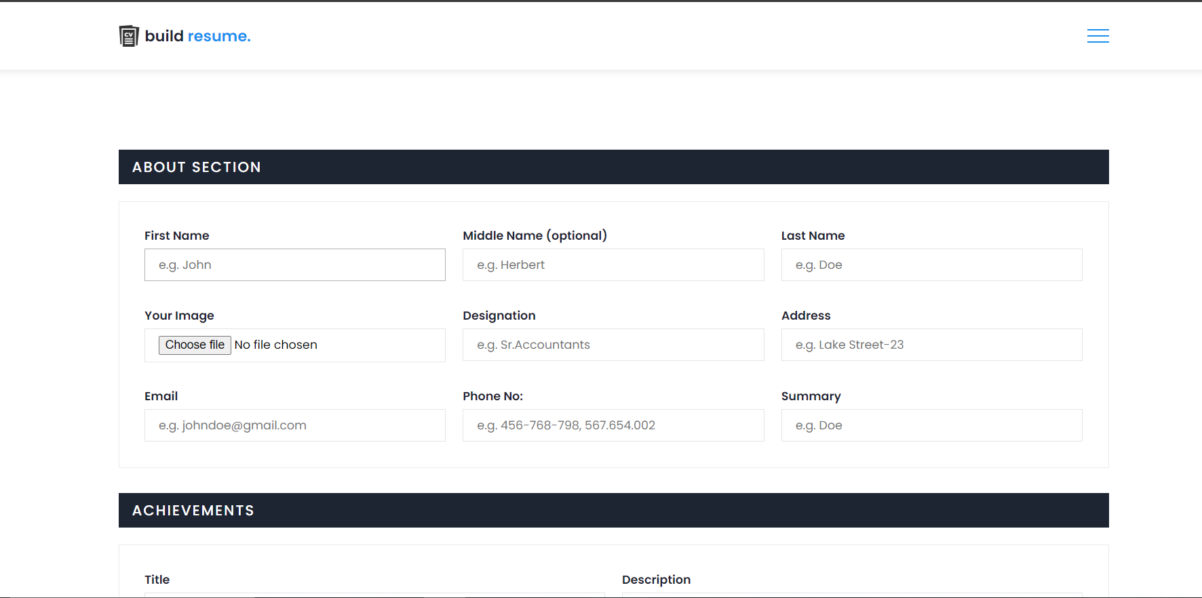
RESULT
Figure : Home Page and Details Filling

Slide 14
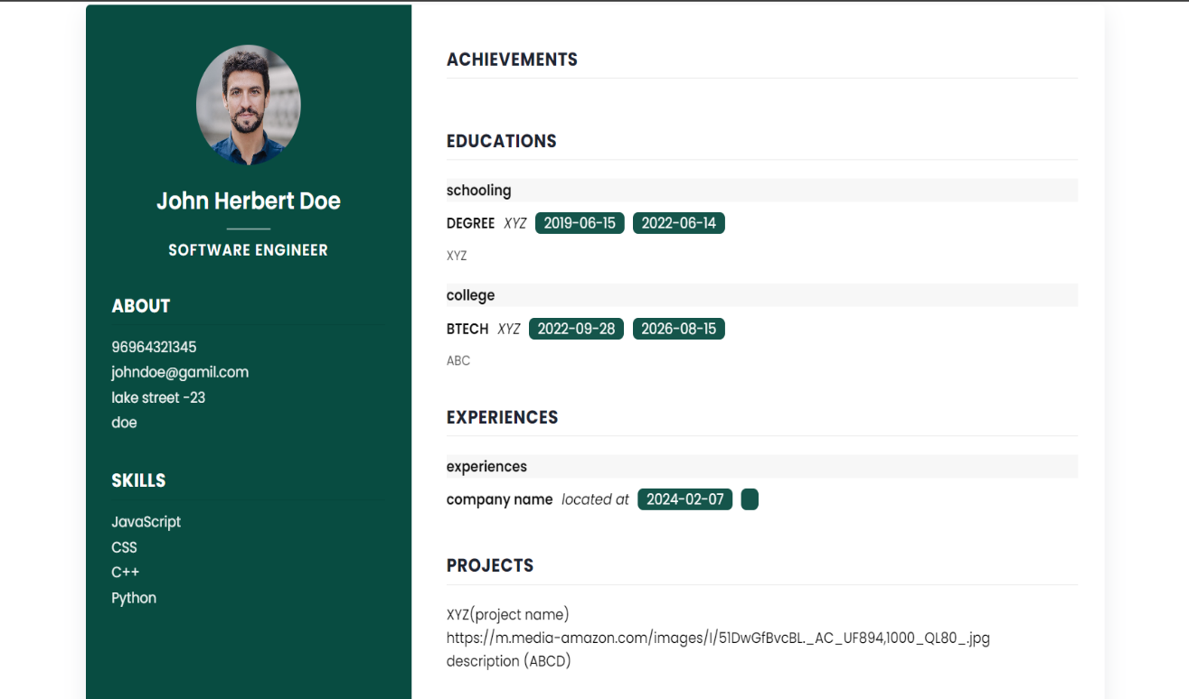
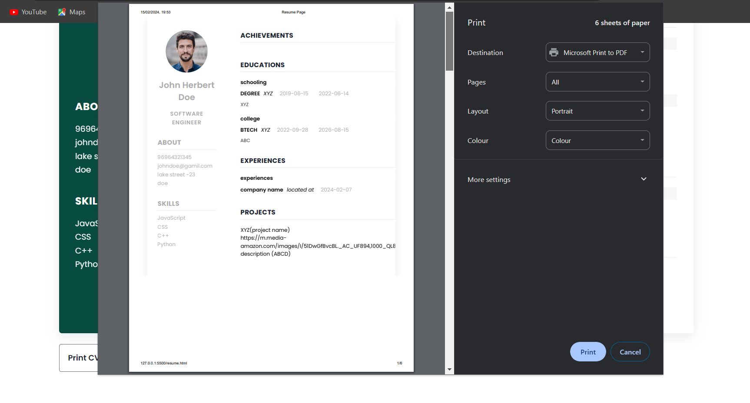
Figure: Previewing and Saving in Different Formats

Slide 15
CONCLUSION
The development of a resume builder website represents a significant milestone in the realm of career management and job search optimization. From capturing personal information and academic qualifications to showcasing skills, hobbies, and work experiences, our resume builder provides users with the tools they need to create compelling and visually appealing resumes that stand out to potential employers. Users are seasoned professionals or recent graduates, our platform ensures a seamless and enjoyable experience. By offering flexibility and customization, we aim to cater to the diverse needs and preferences of our user base, thereby enhancing their chances of securing their desired career opportunities.In addition to its user-centric design, our resume builder prioritizes performance, security, and reliability.

Slide 16
REFERENCES
[1] Bharti Kungwani, Amisha Manglani, Naman Dembal, Hiten Hirani, Laveen Sawlani, “Analytical Resume Builder – A web Application for Creating a resume which gives a best impact in this competitive world”, Annals of R.S.C.B., ISSN:1583-6258, Vol. 24, Issue 2, 2020, Pages. 235 -238, Received 24 October 2020; Accepted 15 December 2020.
[2] Johnson, R., & Lee, S. (2019). "Automated Assistance in Resume Building: Enhancing Formatting and Spell-Checking Features." International Journal of Human-Computer Interaction, 35(8),652-668
[3] Smith, J., Johnson, M., & Anderson, K. (2018). "User-Centric Design in Resume Building Platforms." Journal of User Experience, 12(3), 45-62
[4] https://www.scribd.com/document/287860806/online-resume-builder

Slide 17
THANK
YOU

